Slide 1


AWS
CLOUD COMPUTING INTERNS
2201600038(S.S Deepthee)
2201600058(O.Meghana)
2201600068(sk.Manisha)
2201600065(P.Mounika)
2201600060(N.S.S.Harsha)

Slide 2

S3 BUCKET
A Bucket is a container FOR OBJECTS TO STORE USER DATA IN AMAZON S3.
Usage:
We can use amazon s3 bucket to store and receive any amount of data at any time from anywhere.
LIVE EXAMPLES:
IOT Data Storage
Mobile app development
Data Warehouse
Data Migration and Transfer

Slide 3
Objects:-
Objects are the entities which are stored in an S3 bucket.
An object consists of object data and metadata where metadata is a set of name-value pair that describes the data.
Properties:
When you create an S3 bucket, you will have a management page where you can manage your bucket. On this page, if you click the Properties section, you will see a bunch of sections.It consists of
Bucket Overview
Bucket Versioning
Tags
Default Encryption
Intelligent-Tiering Archive configurations
Server Access Logging
Static Web Hosting:Although S3 is an object-based storage solution, it can host static web pages. Since S3 is not a server, it cannot host dynamic web pages. To bring a static web page to live, first, the web page files are uploaded to the S3 bucket. “Static web hosting” feature is activated and the web page will be accessible in a few seconds after the path information of the index page and error page is given.

Slide 4
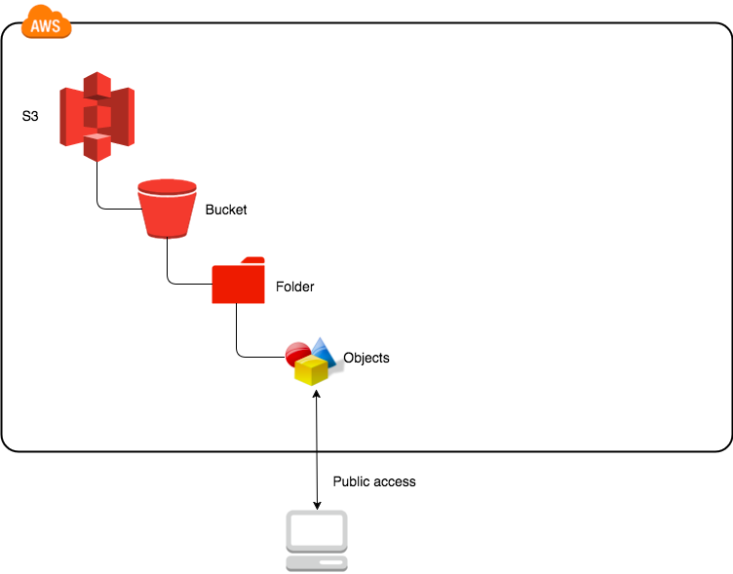
STEPS TO CREATE S3 BUCKET:
At first we should create s3 bucket.
Next we should to edit the properties.
Now we have to give permission.
ACL permission should be enabled.
By adding the files to the bucket, we can fill the bucket with the files.
Now make all files public.
At the final we navigate to the properties and open the link.

Slide 5
STEPS FOR CREATING S3 BUCKET
Create an AWS Account: If you don't have one, sign up for an AWS account at https://aws.amazon.com/.
STEP-1:Access the AWS Management Console: Log in to the AWS Management Console using your AWS account credentials.
STEP-2: Navigate to S3: Once logged in, navigate to the S3 service from the AWS Management Console dashboard.
STEP-3:. Create a Bucket: Click on the "Create bucket" button and follow the instructions to set up your S3 bucket. You'll need to choose a unique bucket name, select a region for the bucket, and configure any optional settings.

Slide 6
STEP-4: Set Bucket Permissions: By default, the bucket and its objects are private. Depending on your use case, you might need to configure bucket policies or Access Control Lists (ACLs) to manage access permissions.
STEP-5: Upload and Manage Objects: Once the bucket is created, you can start uploading files or objects to it using the AWS Management Console, AWS SDKs, or AWS CLI.
STEP-6: Integrate with Applications: To use the S3 bucket in your applications or services, you'll need to interact with the AWS SDKs or APIs provided by AWS for your preferred programming language.

Slide 7
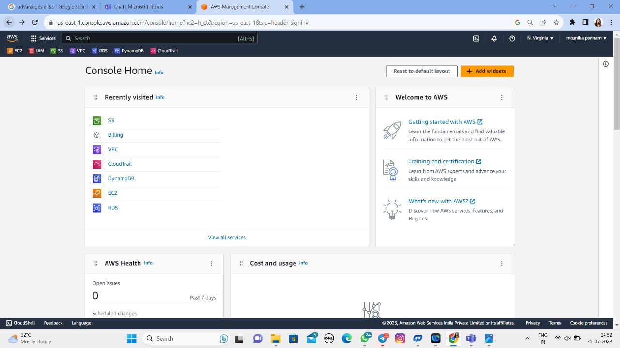
STEP-1

Slide 8
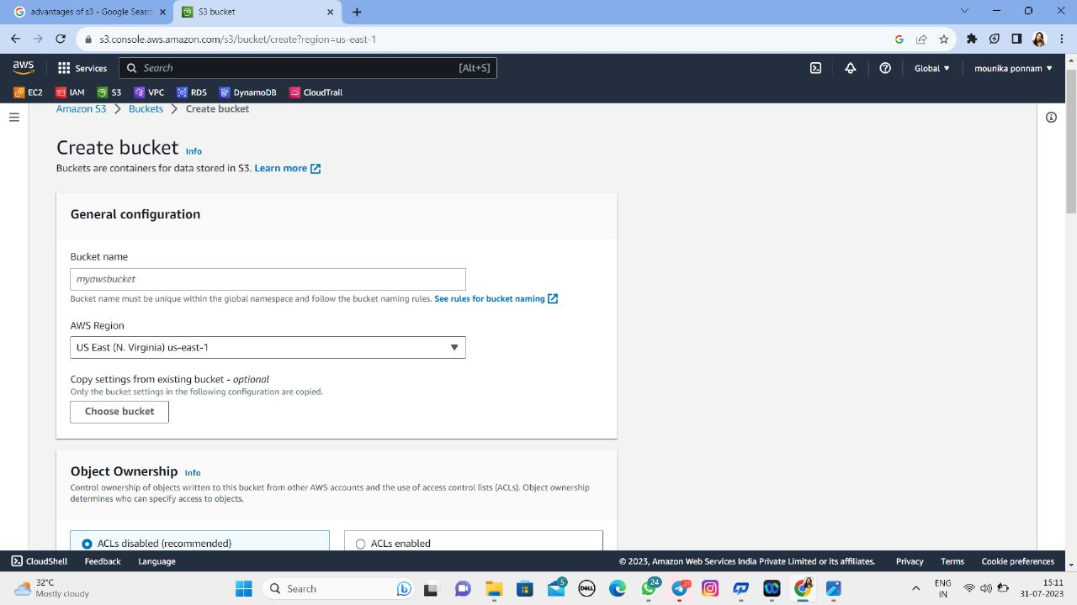
Step-2:

Slide 9
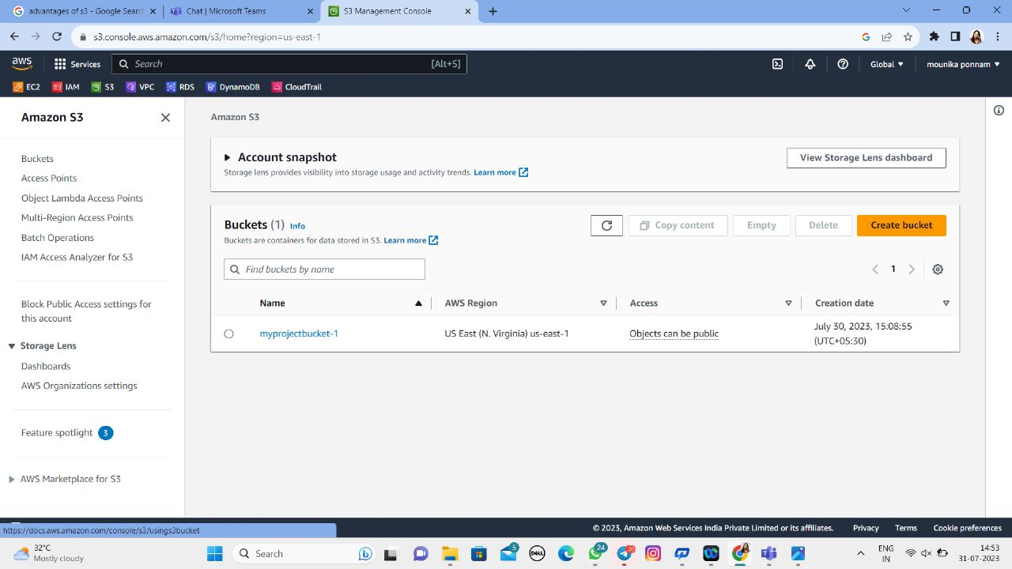
Step-3:

Slide 10
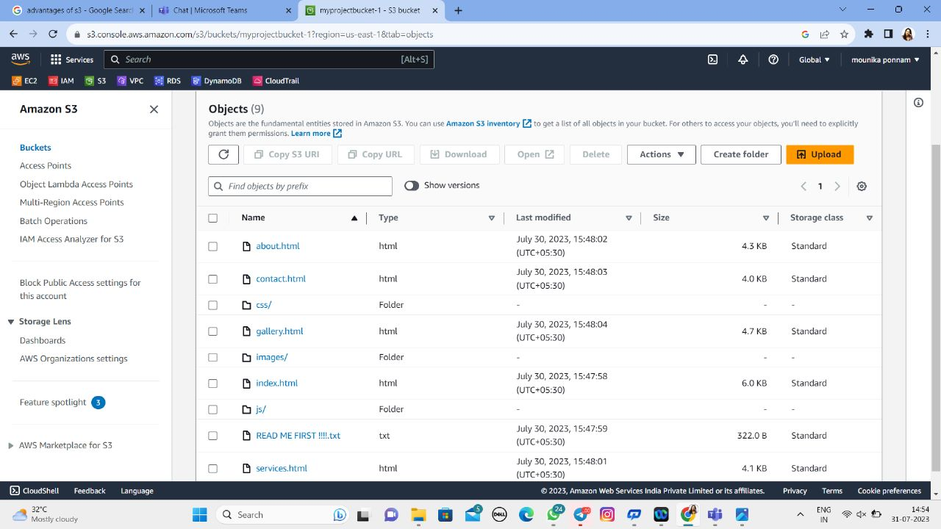
Step-4:

Slide 11
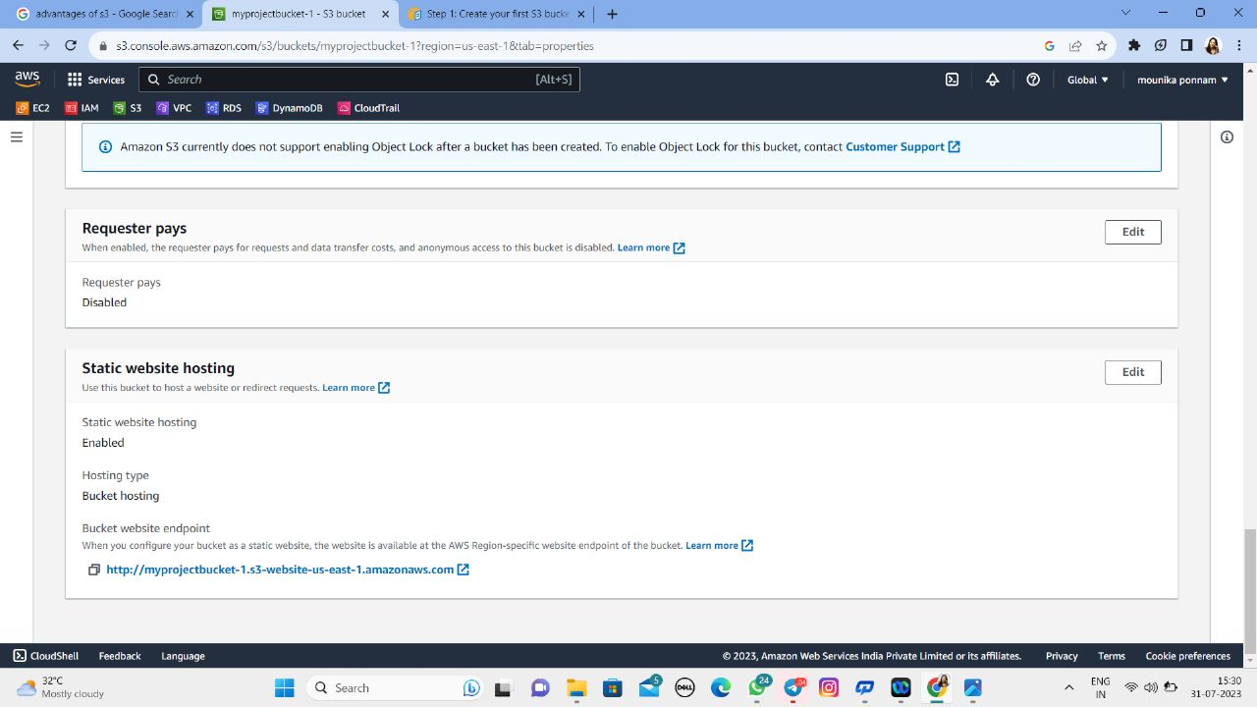
Step-5:

Slide 12
LETS SEE…. OUR INSPIRA RESORT WEBPAGE DEVELOPED BY USING AWS S3 BUCKET

Slide 13
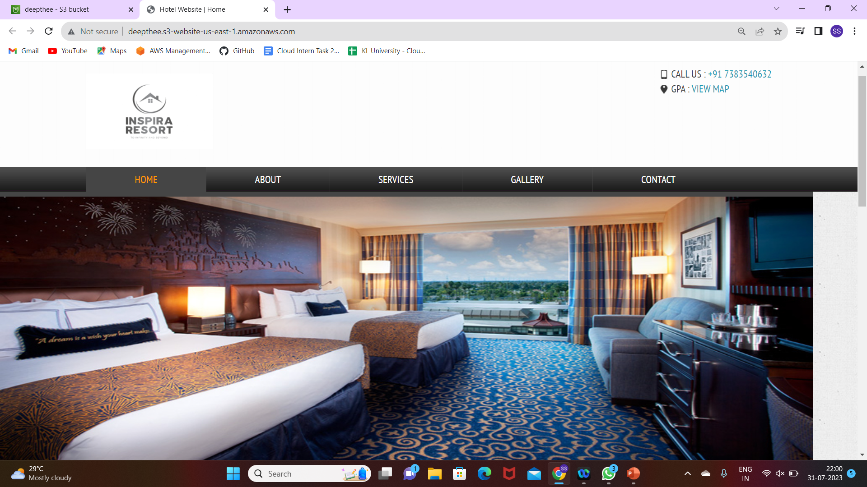

Slide 14
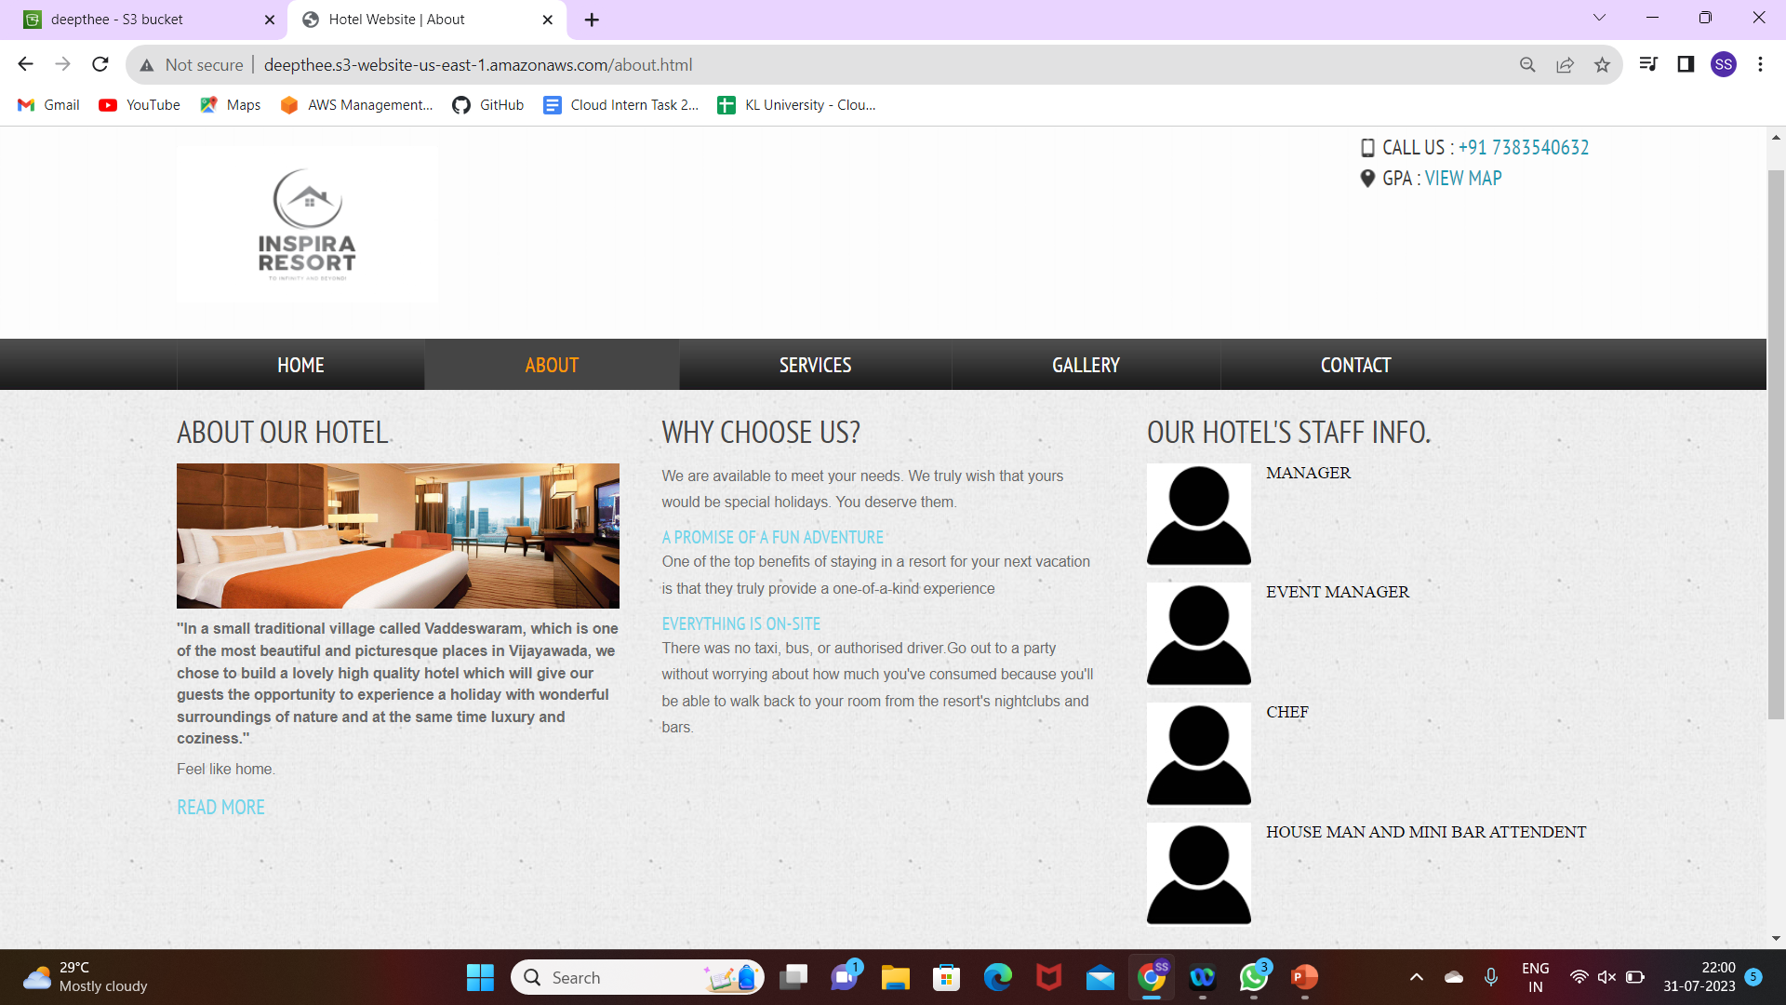

Slide 15
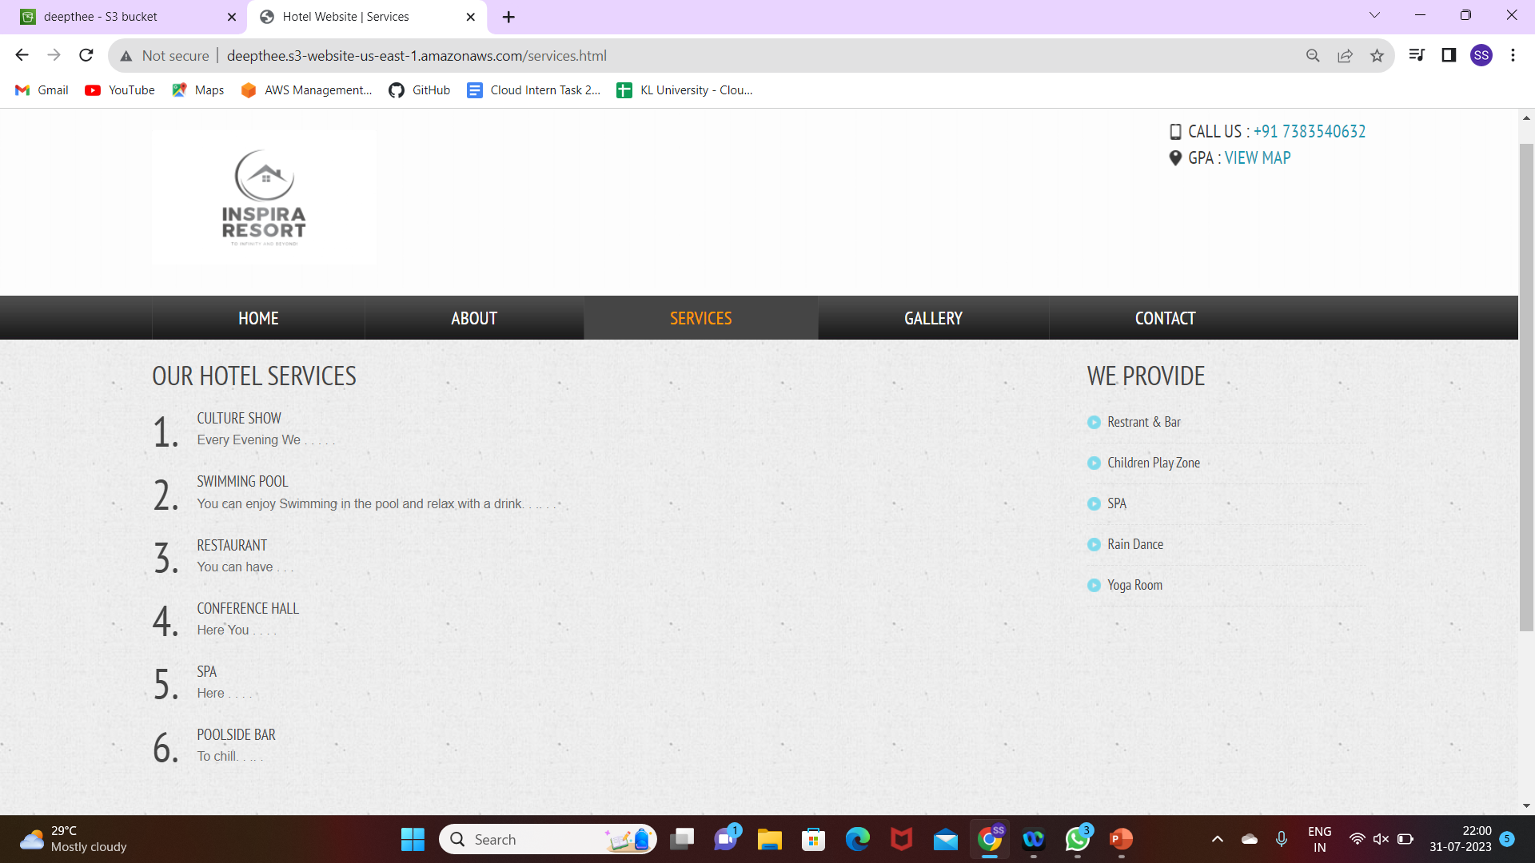

Slide 16
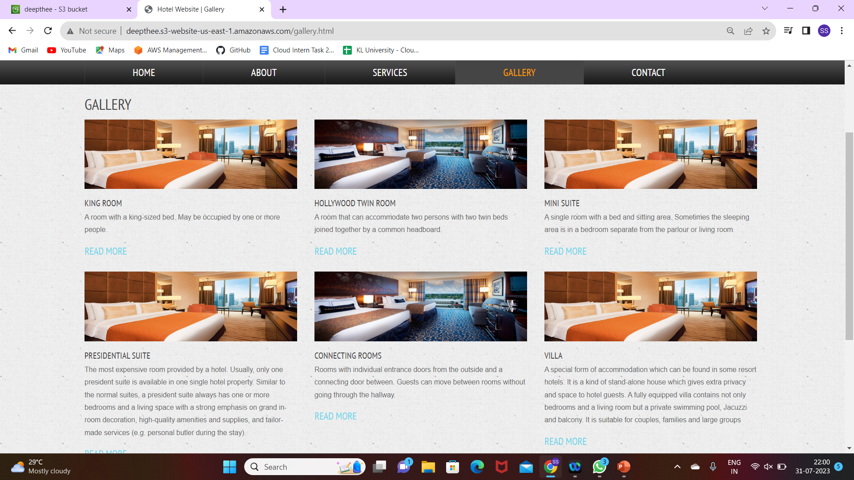
Inventory by Day

Slide 17
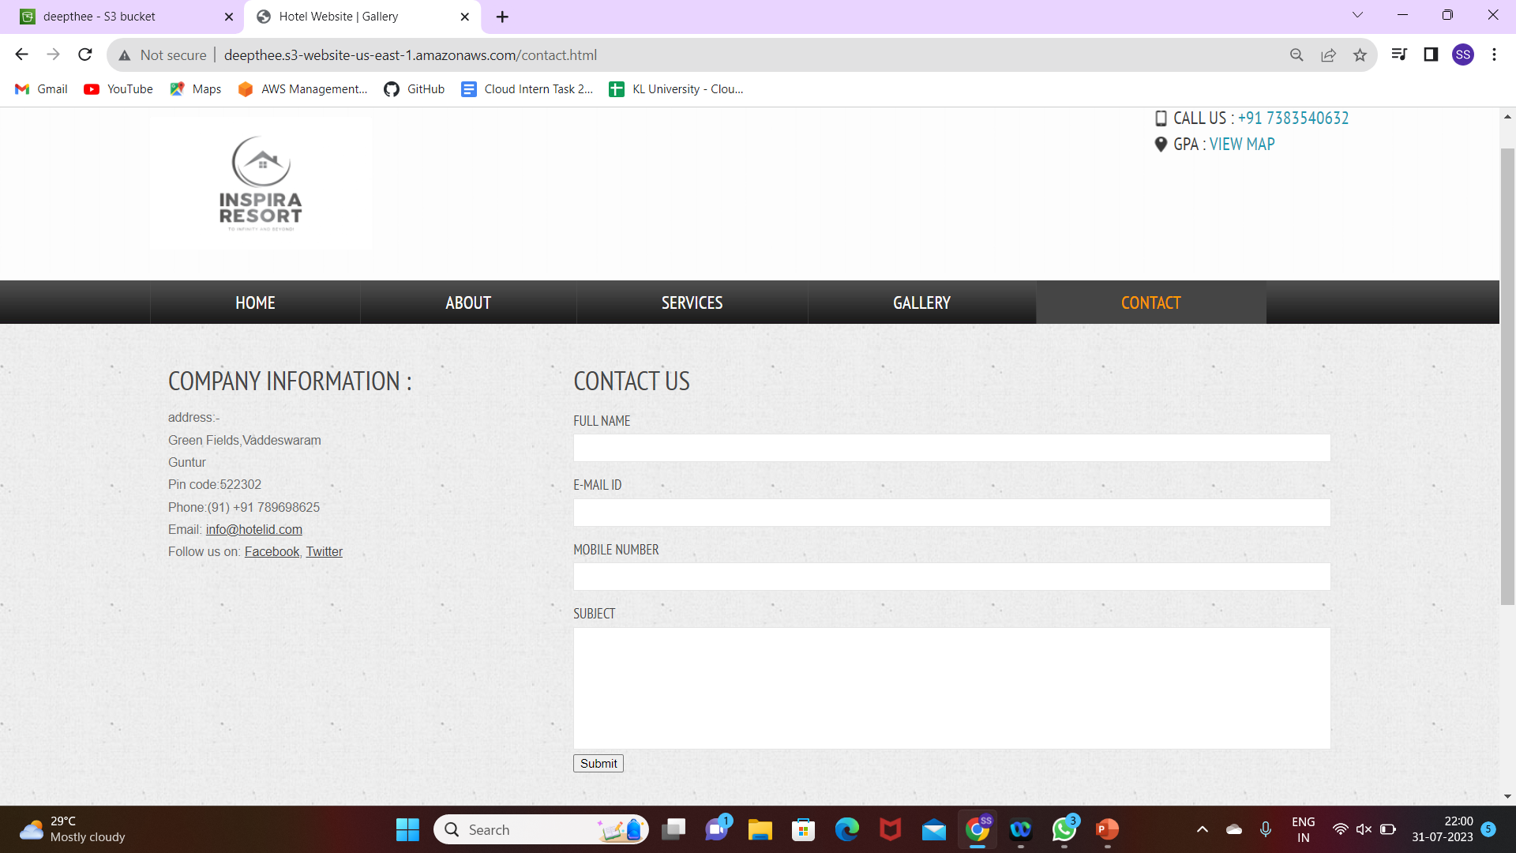

Slide 18

Successful Project
ON TIME
WITHIN BUDGET
TEAMWORK

Slide 19


